Slide 1
3rd RNAseq for HTT Splicing Enhancers
Zhen, Dann, Catherine, Joon, Magnus, Jessica
Mar 13, 2023

Slide 2
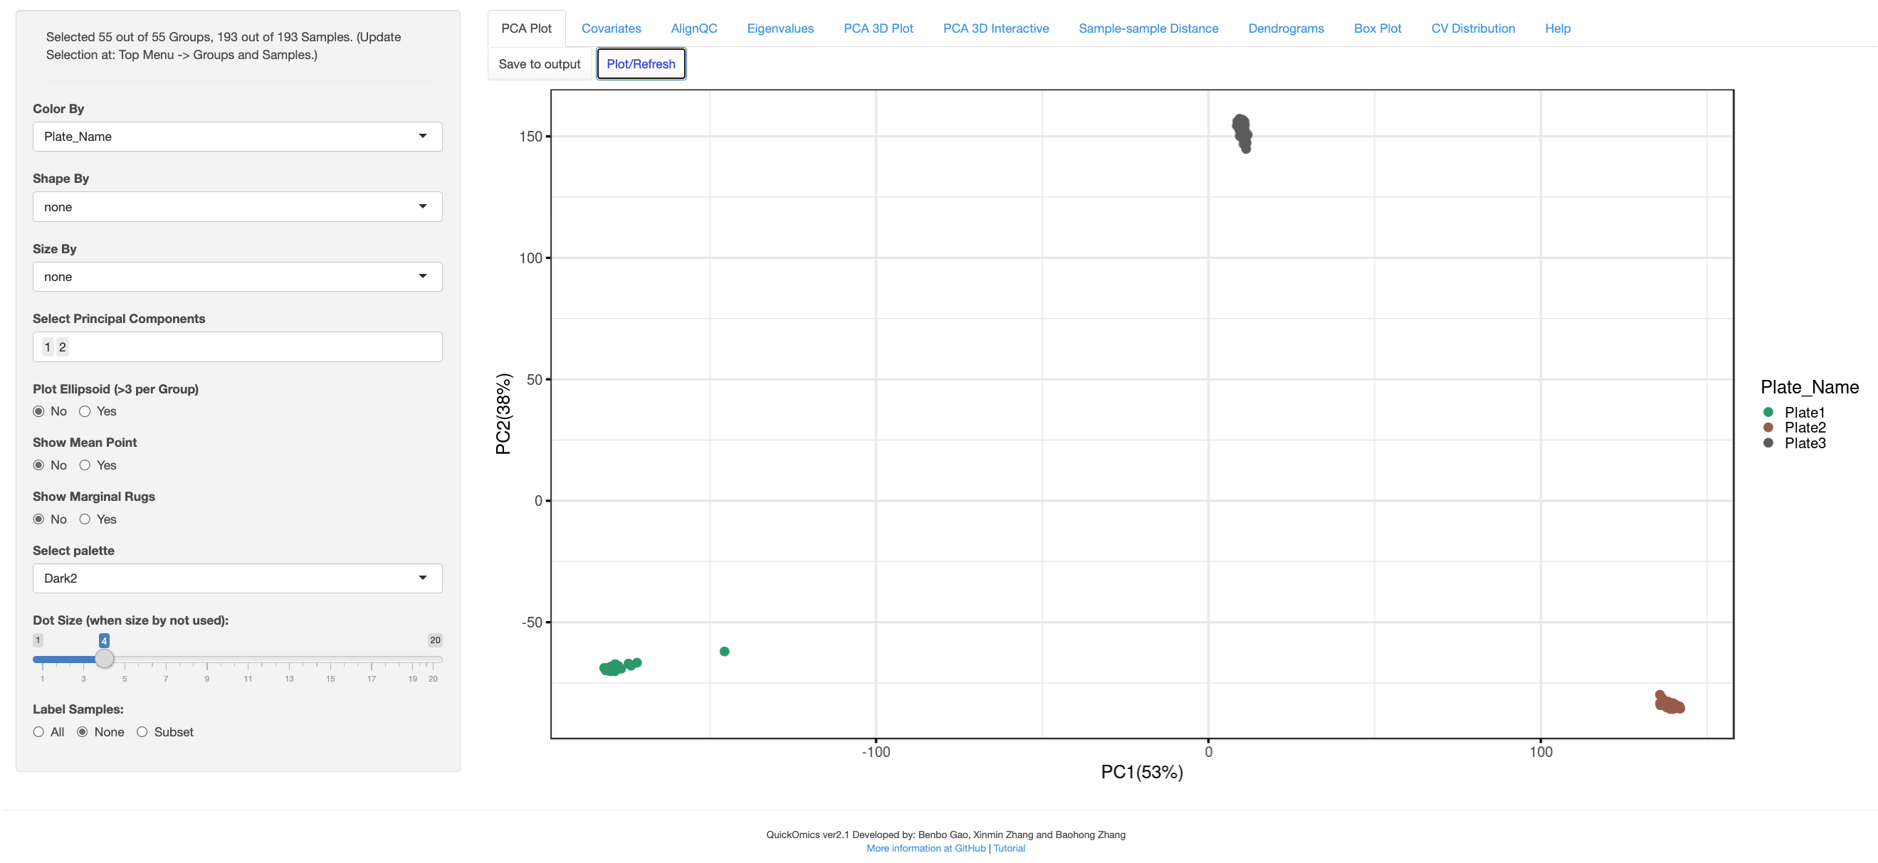
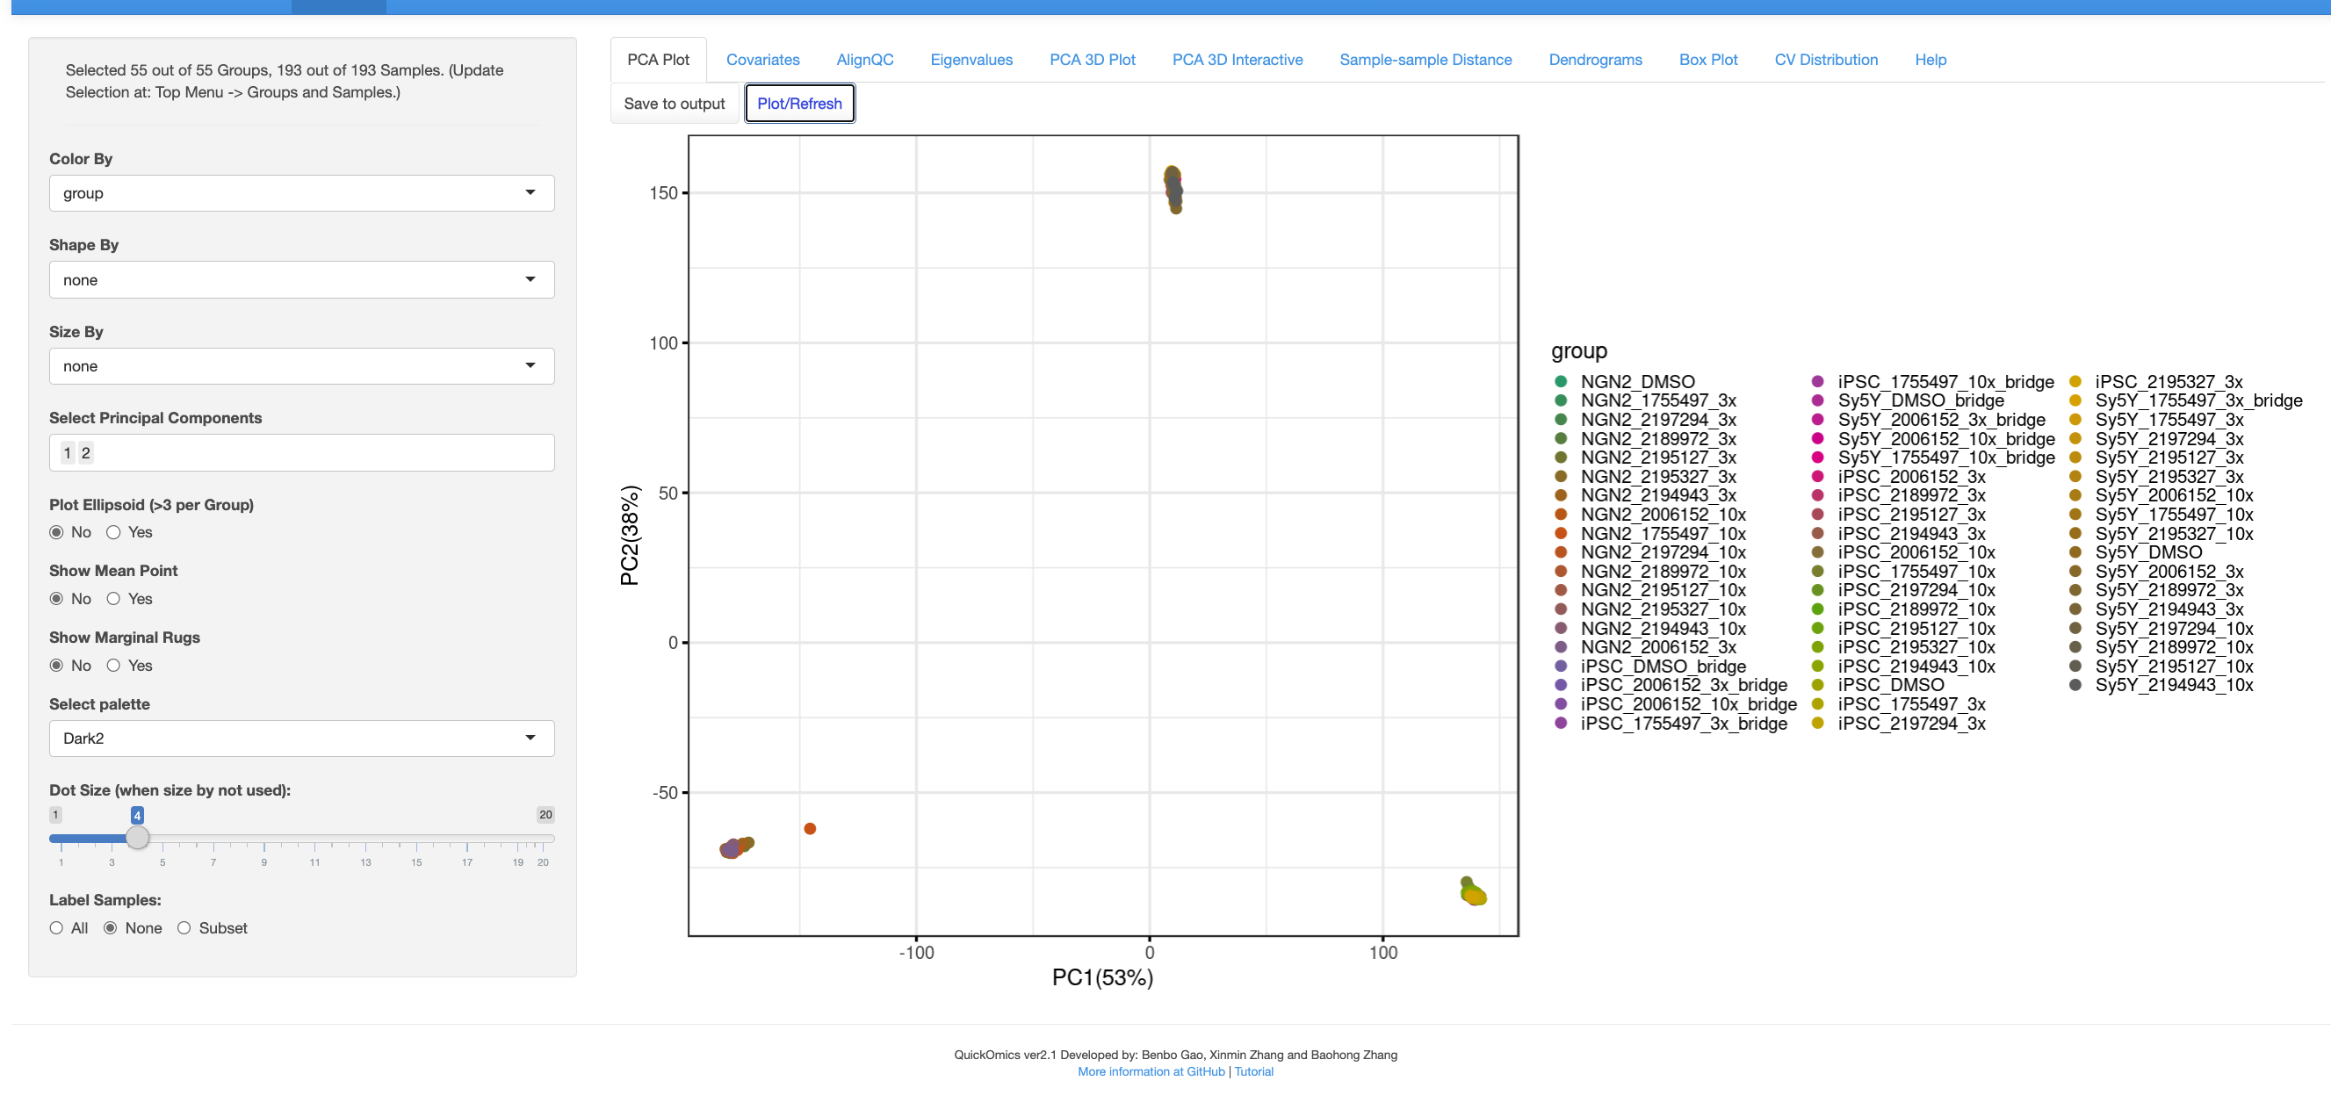
PCA of all samples

Slide 3
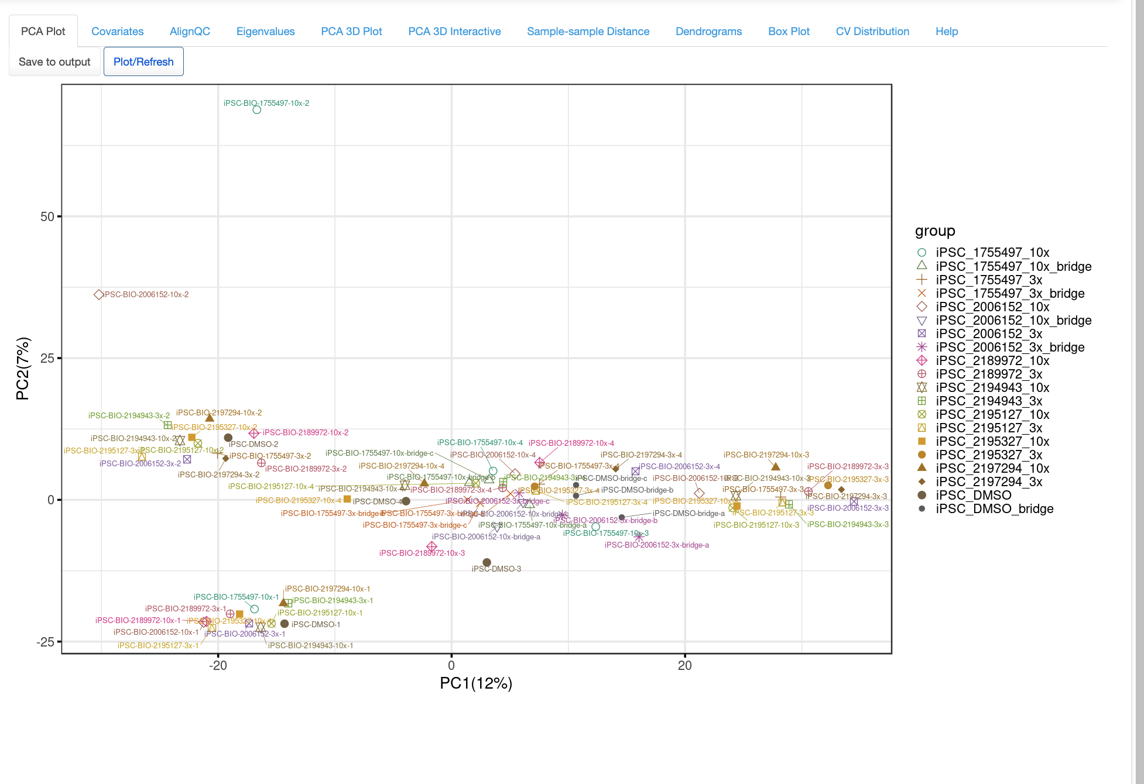
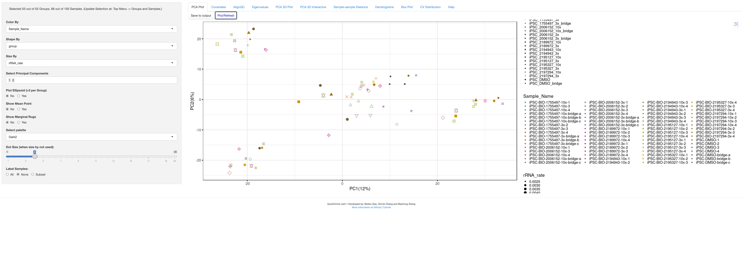
PCA of iPSC samples

Slide 4
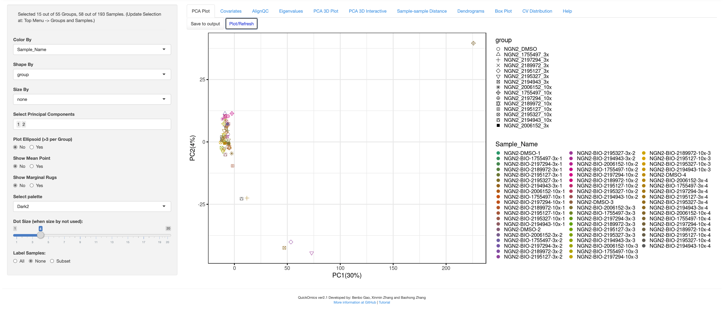
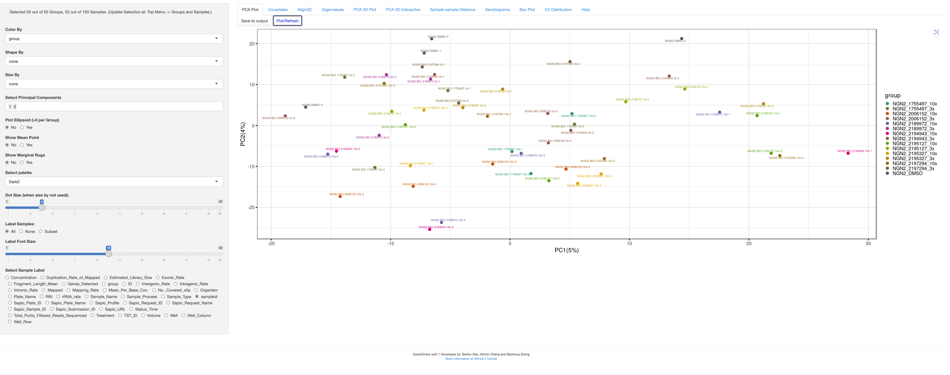
PCA of NGN2 samples

Slide 5
PCA of Sy5Y samples

Slide 6
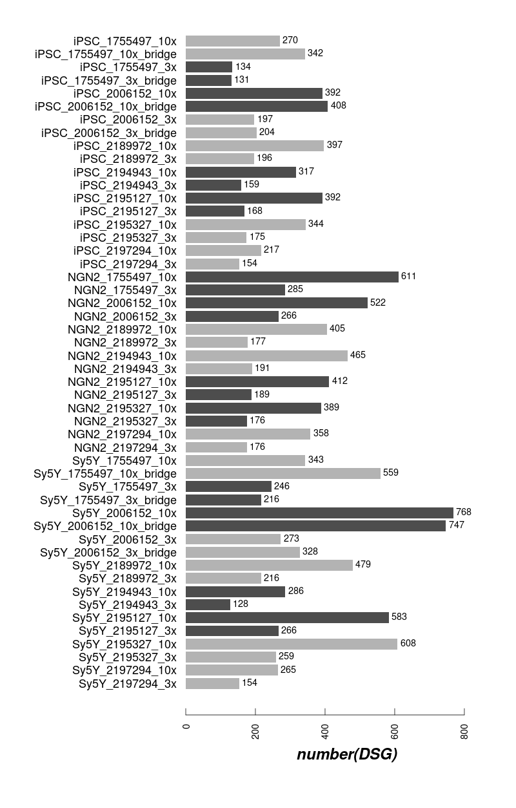
The numbers of DSG induced by compounds

Slide 7
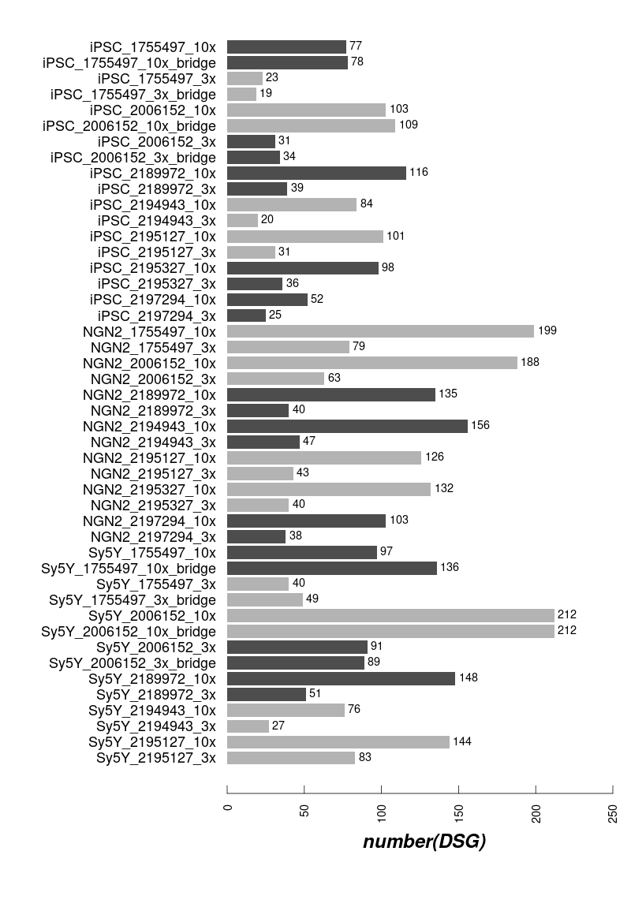
The numbers of DSG induced by compounds

Slide 8
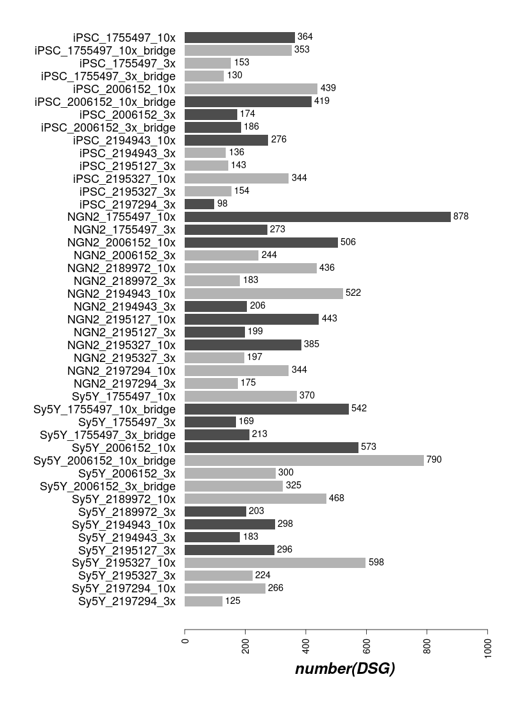
The numbers of DSG induced by compounds
3 Treatment vs 3 Control Samples
All avalaible Treatment vs 4 Control Samples

Slide 9
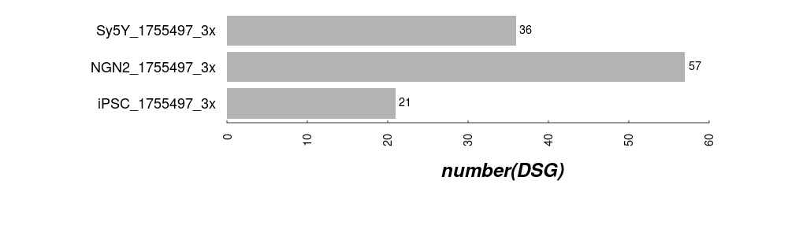
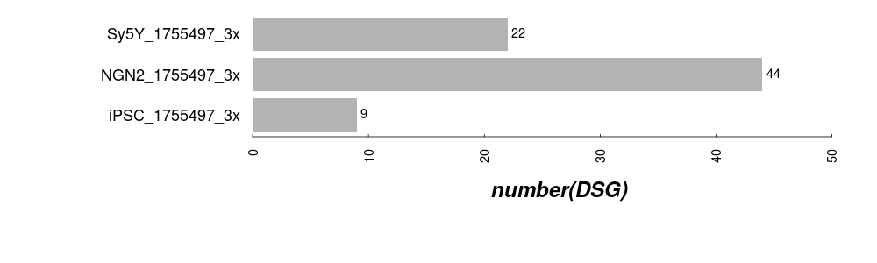
The numbers of DSG induced by compounds
50% subset
25% subset

Slide 12
[NGS One]/TST12086:
Data for TST12086 is ready.
Ravi Teja

Slide 13
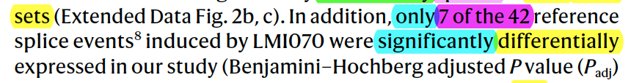

Slide 14
Main Goals of the RNAseq
Discover the compounds have fewer off-targets and but strong on-target effects
Determine the common targets among the SM splicing enhancers
Explore potential novel splicing targets
Confirm the system difference between the different cell-systems (iPSC and NGN2)
Seek the best procedure for cross-experiments/cross-cell-systems comparison
Make robust and cost-efficient experimental design, QC etc.
Sep 26, 2022
Zhen, Dann, Catherine, Joon, Magnus, Jessica

Slide 15
RNA-seq Study #1
Goal: Transcriptome-wide RNA-seq of Benchmark/competitor HTT splice modulators and current BIIB lead compounds in neurons and proliferating cell type for off-target profiling.
Compound | CRL HTRF IC50 (nM) | Internal HTRF IC50 (nM) | Internal iPSC qPCR IC50 (nM) | Internal NGN2 qPCR IC50 (nM) | ~3x IC50 Dose (nM) | Actual X-fold IC50 (iPSC) | Actual X-fold IC50 (NGN2) | ~10x IC50 Dose (nM) | Actual X-fold IC50 (iPSC) | Actual X-fold IC50 (NGN2) | Notes
BIO-1755497 | 121 | 4 | 10.75 | 3.023 | 12 | 1.12 | 3.97 | 40 | 3.72 | 13.23 | Branaplam
BIO-2006152 | 87 | 15 | 14.14 | 7.6185 | 45 | 3.18 | 5.91 | 150 | 10.61 | 19.69 | PTC-518 guess
BIO-2059811 | 87 | Expected <100nM | 101.5 | 65.19 | 261 | 2.57 | 4.00 | 870 | 8.57 | 13.35 | PTC different core
BIO-2135644 | 100 | Expected <100nM | 81.68 | 68.31 | 300 | 3.67 | 4.39 | 1000 | 12.24 | 14.64 | PTC different core
BIO-2136770 | 100 | Expected <100nM | 41 | 24.59 | 300 | 7.32 | 12.20 | 1000 | 24.39 | 40.67 | Close PTC518 analog
BIO-1949634 | 1500 | 6200 | 357.55 | 289 | 3000 | 8.39 | 10.38 | 10000 | 27.97 | 34.60 | Risdiplam
BIO-2060573 | 5780 | 670 | 298.2 | 271.5 | 3000 | 10.06 | 11.05 | 10000 | 33.53 | 36.83 | Internal lead/different core
BIO-2070692 | 560 | 50 | 140.4 | 104.4 | 1680 | 11.97 | 16.09 | 5600 | 39.89 | 53.64 | Remix example
BIO-2060884 | 370 | 240 | 113.8 | 105.9 | 3700 | 32.51 | 34.94 | 10000 | 87.87 | 94.43 | Internal lead
DMSO | - | - | - | - | - | - |  | -
 |  |  | Determined after RNAseq study |  |  | Determined after RNAseq study |  |  | Determined after RNAseq study
*Dosed correctly and used as reference across RNAseq studies
7189L WT Cell lines:
iPSCs (100K)
NGN2 (DIV14, 200K)
Treatment:
24hr
Replicates:
3 biological
Total Samples:
114 (9 cpds + DMSO)

Slide 16
RNA-seq Study #2
Goal: Transcriptome-wide RNA-seq of potent BIIB lead compounds in neurons and proliferating cell type for off-target profiling in comparison to PTC518 and other competitor compounds.
Compound | Internal HTRF IC50 (nM) | Internal iPSC qPCR IC50 (nM) | Internal NGN2 qPCR IC50 (nM) | ~3x IC50 (iPSC) | ~10x IC50 (iPSC) | ~3x IC50 (NGN2) | ~10x IC50 (NGN2) | Notes
BIO-2006152 | 15.0 | 14.14 | 7.62 | 42 | 141 | 23 | 76 | REFERENCE, ~PTC-518
BIO-2175420 | 11.5 | 14.50 | 5.28 | 43 | 145 | 16 | 53 | great KPuu imidazopyridine
BIO-2139701 | 38.3 | 19.95 | 5.60 | 60 | 199 | 17 | 56 | imidazopyridine other RHS
BIO-2176866 | 91.7 | 70.41 | 8.83 | 211 | 704 | 26 | 88 | benzimidazole
BIO-2184088 | 21.0 | 26.18 | 11.16 | 79 | 262 | 33 | 112 | sulfur
BIO-2184090 | 65.0 | 49.36 | 30.86 | 148 | 494 | 93 | 309 | sulfur other RHS
BIO-2174714 | 191.0 | 113.90 | 52.60 | 342 | 1139 | 158 | 526 | indazole
BIO-2186960 | 32.9 | 16.77 | 10.18 | 50 | 168 | 31 | 102 | triazole 1
BIO-2186527 | 36.4 | 32.36 | 19.24 | 97 | 324 | 58 | 192 | triazole 2
BIO-2174748 | 74.5 | 37.62 | 22.08 | 113 | 376 | 66 | 221 | oxazole
BIO-2184741 | 56.0 | 147.60 | 96.21 | 443 | 1476 | 289 | 962 | BENCHMARK, Remix cpd
DMSO | - | - | - | - | - | - | -
7189L WT Cell lines:
iPSCs (100K)
NGN2 (DIV14, 200K)
Treatment:
24hr
Replicates:
4 biological
Total Samples:
192 (11 cpds + DMSO)

Slide 17
Structures of Some SM Splicing Enhancers

Slide 18
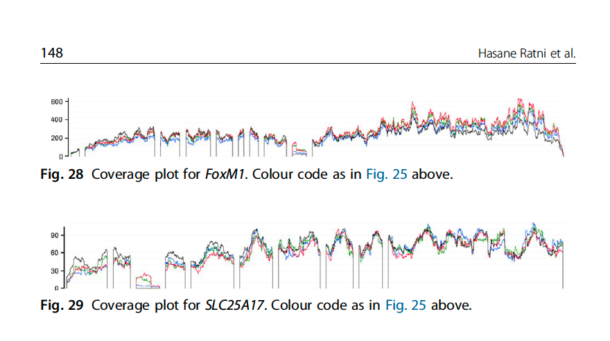
On-Targets and Off-Targets sequences
 | Doner Splice Site Consensus
 | AG|GTRAG
Gene Names | Risdiplam Consensus Binding sequence
HTT | AGA|GTTAG
APLP2 | GA|GTAAG
FOXM1-inside | GA|GTAAG
FOXM1-border | CA|GTAAG
SLC25A17-inside | GA|GTAAG
SLC25A17-border | AG|GTTAA
ref:
Ratni Roche review, Progress Medicinal Chem V58, 2019
Anuradha Bhattacharyya et. Al. Nature Comm. 2021

Slide 19
Sample similarity from Gene Expression (1st exp)
PCA in 2D for iPSC
PCA in 2D for NGN2

Slide 20
Sample similarity from Gene Expression (2nd exp raw)
PCA in 2D for iPSC
PCA in 2D for NGN2

Slide 21
Sample similarity from Gene Expression (2nd exp raw after removal of low-quality samples)
PCA in 2D for iPSC
PCA in 2D for NGN2

Slide 22
Sample similarity from Gene Expression (2nd exp raw after removal of R4)
PCA in 2D for iPSC
PCA in 2D for NGN2

Slide 23
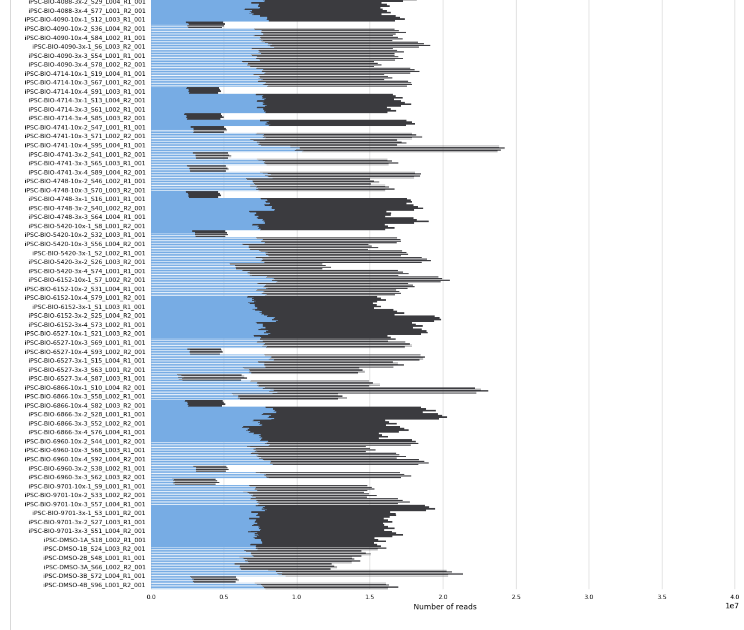
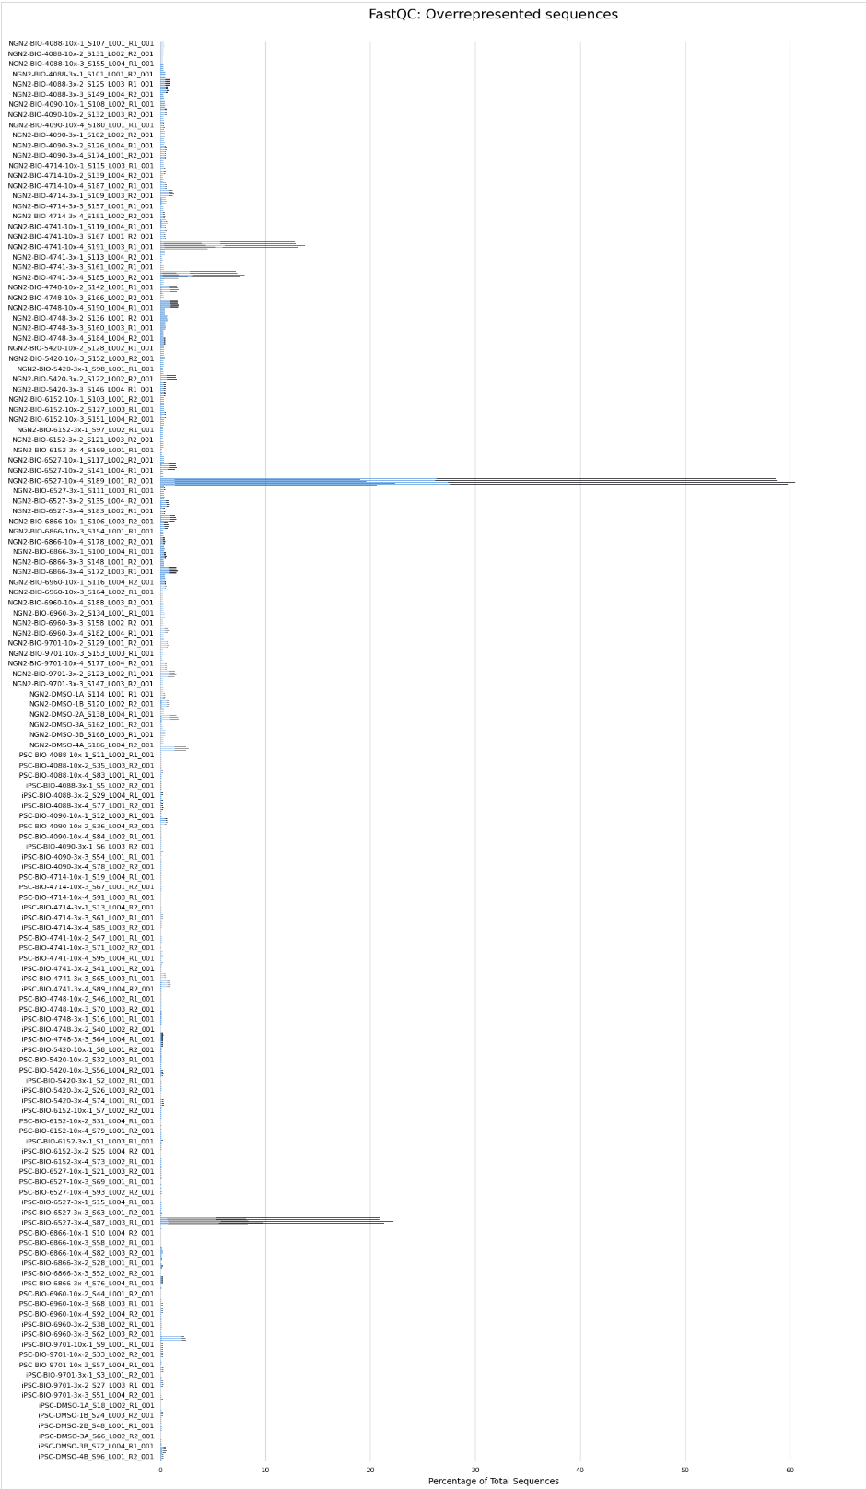
MultiQC
Total Reads
Overrepresented Sequences %
/Users/zgao1/Documents/RNAseq/TST11955_BACK/QC/MultiQC Report_TST11955.html

Slide 24
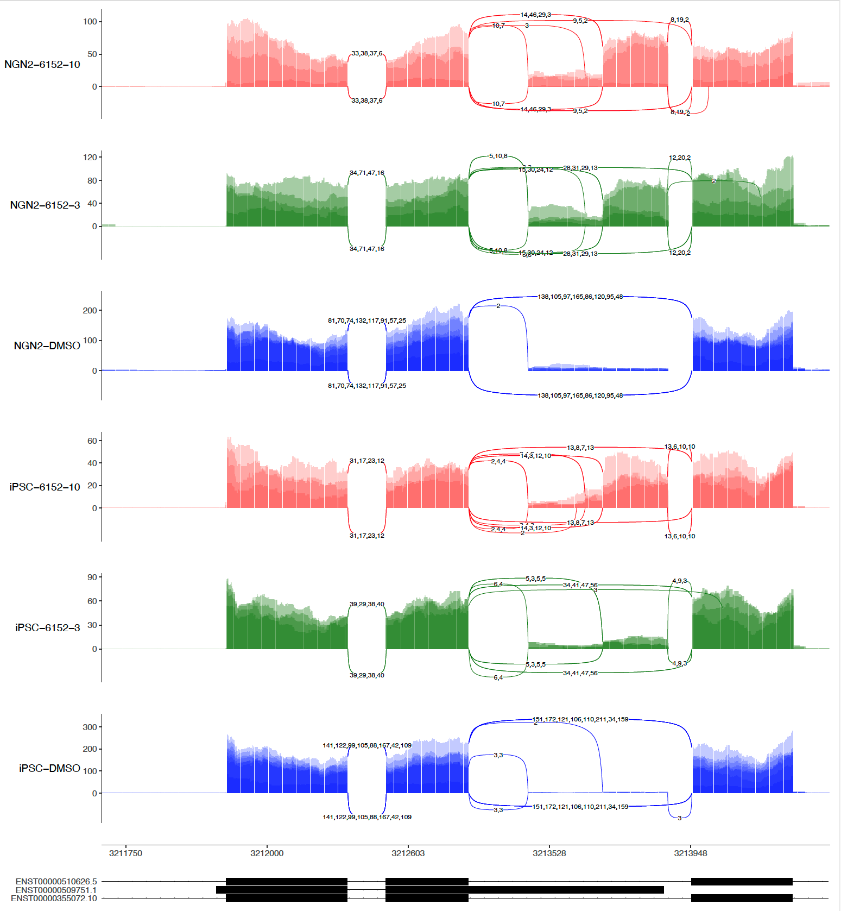
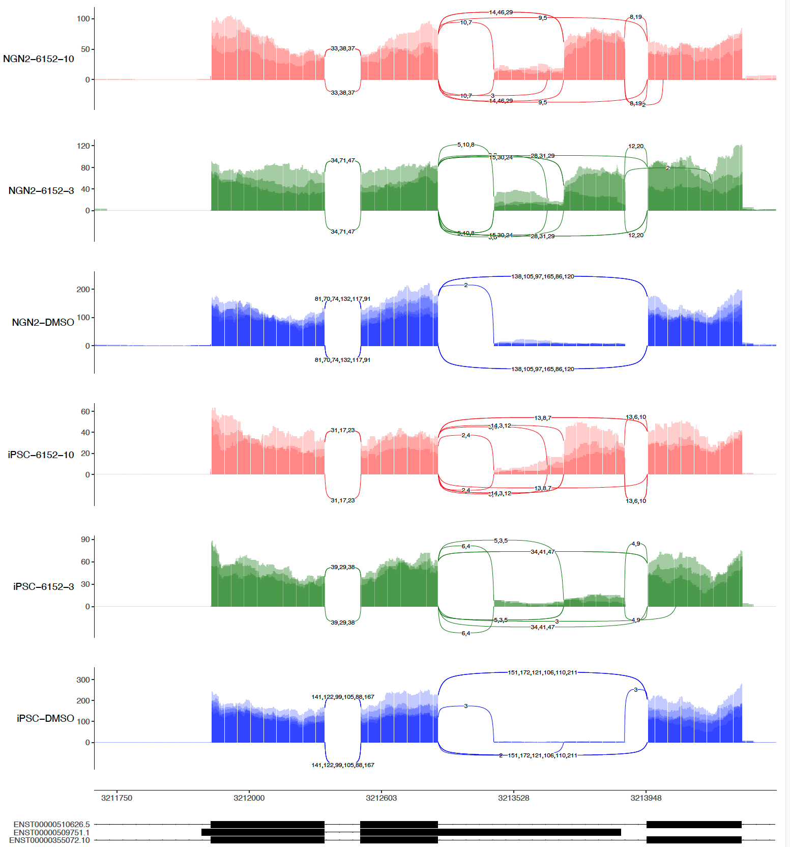
sashimi-plots: HTT gene in 2nd 6152 (4 vs 3 Repeats)
4 repeats
3 repeats (No R4)

Slide 25
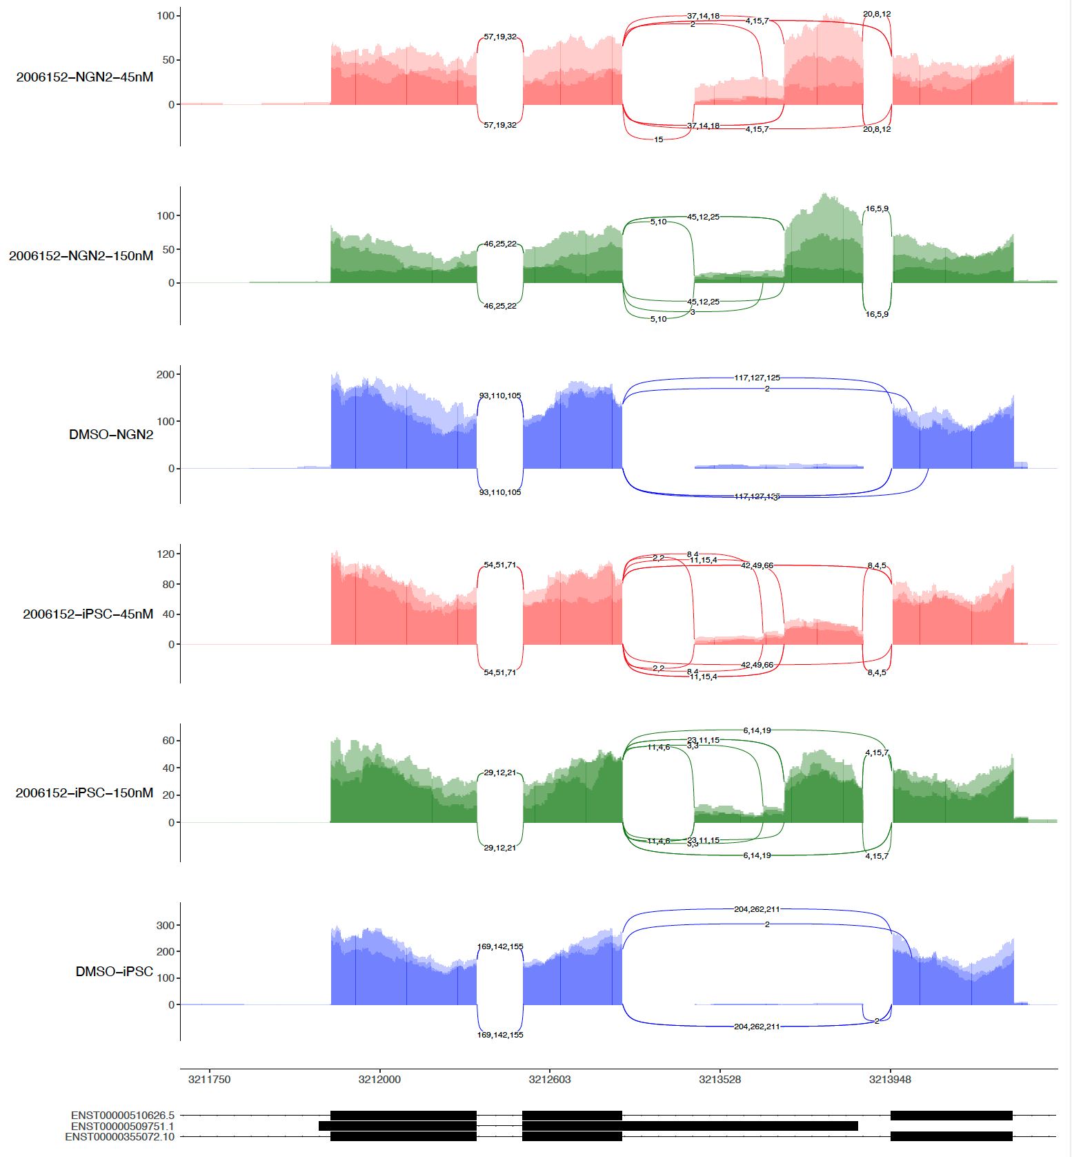
sashimi-plots: HTT gene in 1st and 2nd 6152
1
2
3
4

Slide 26
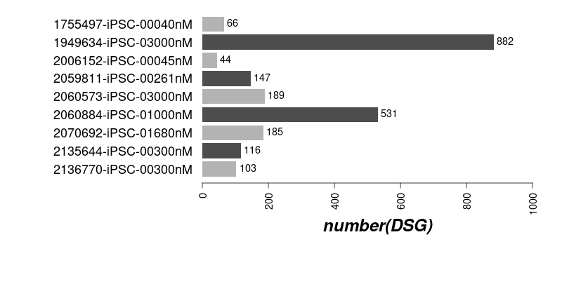
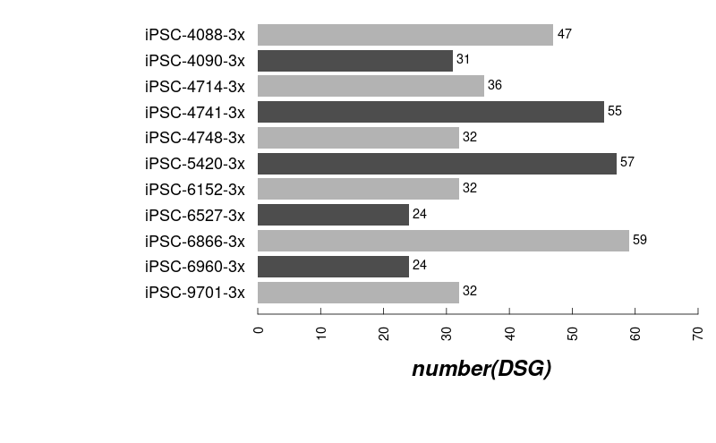
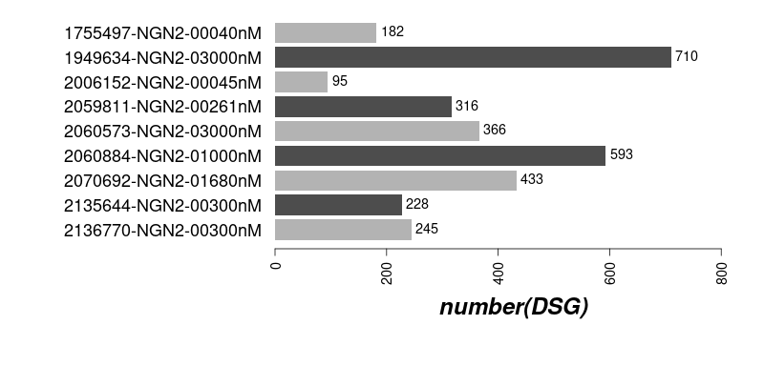
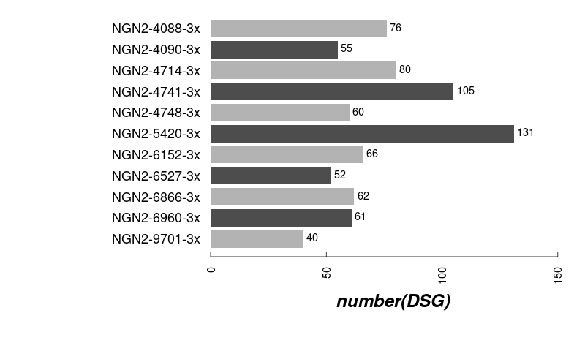
The numbers of DSG induced by compounds (3x)
1st iPSC
2nd iPSC
1st NGN2
2nd NGN2

Slide 27
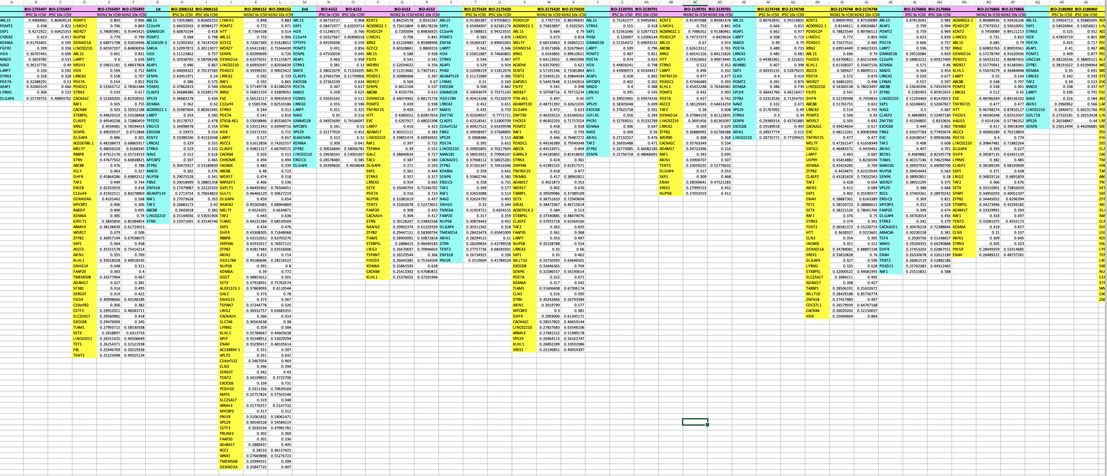
The details DSG induced by compounds (3x & 10x)
6152 1st iPSC & NGN2 and 2nd iPSC & NGN2

Slide 28

The DSG Induced by Compounds in the 2 cell systems

Slide 29
The Clustering of Compounds in the 2 cell systems

Slide 30
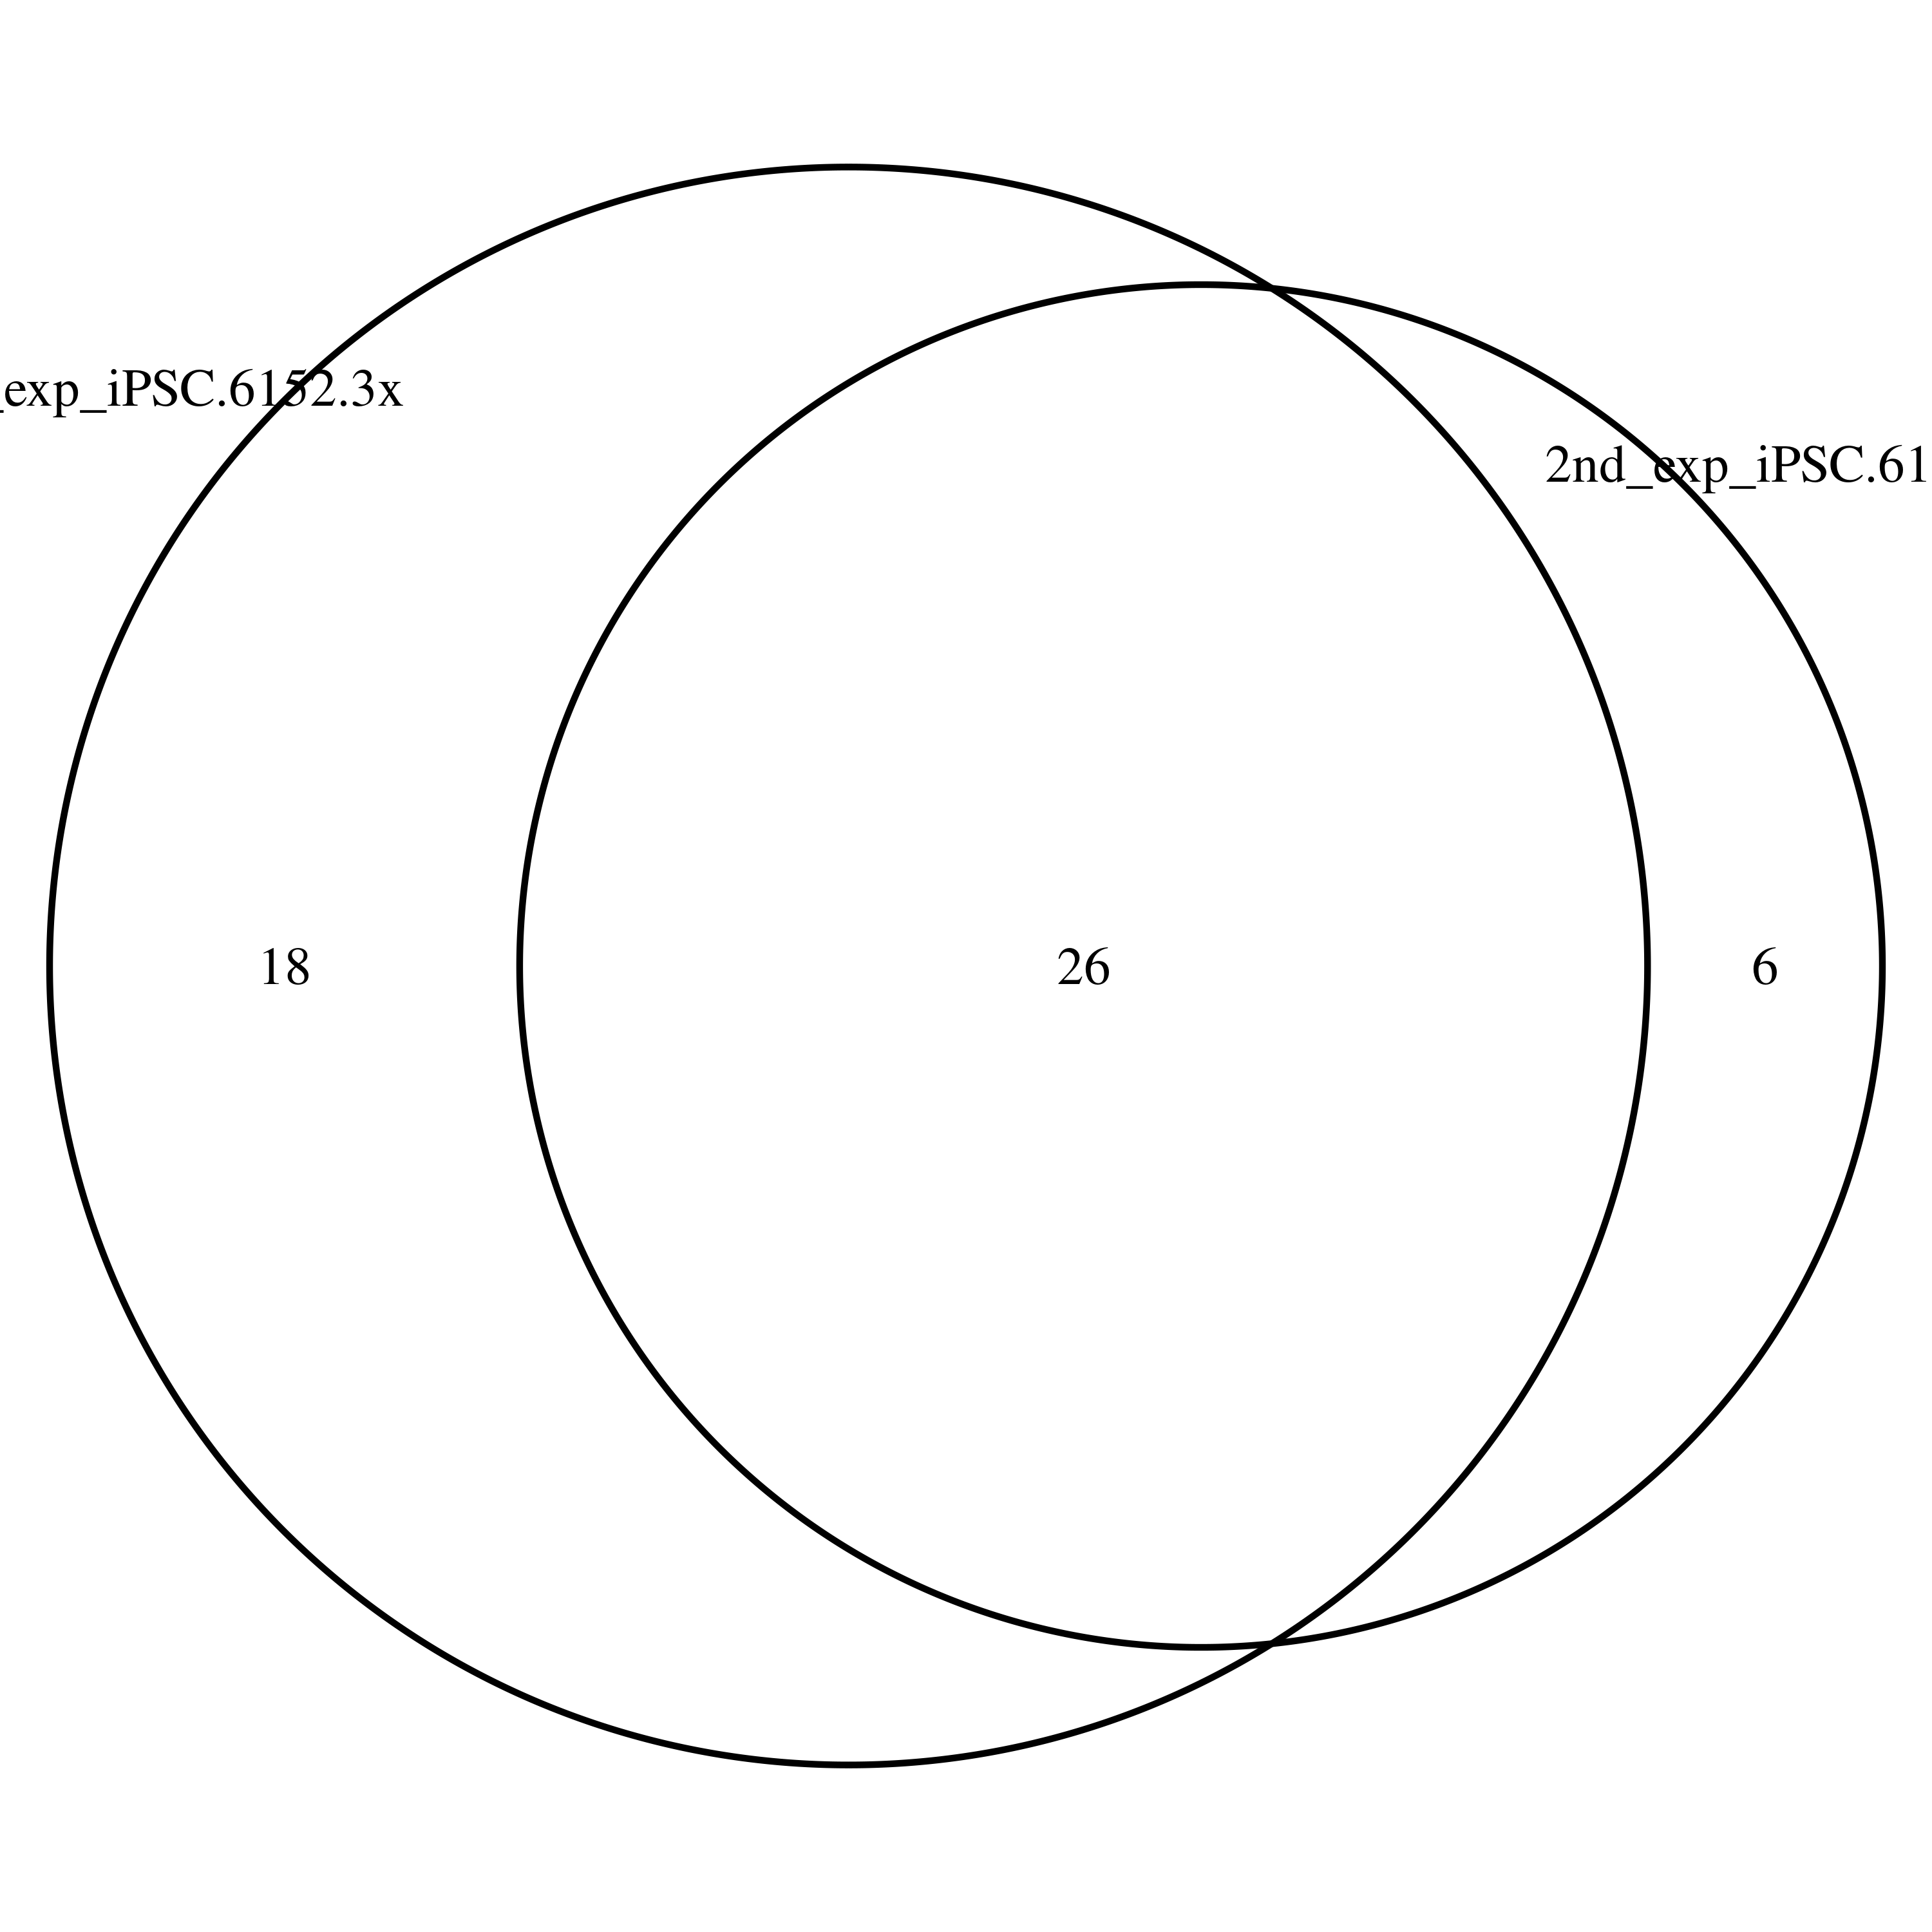
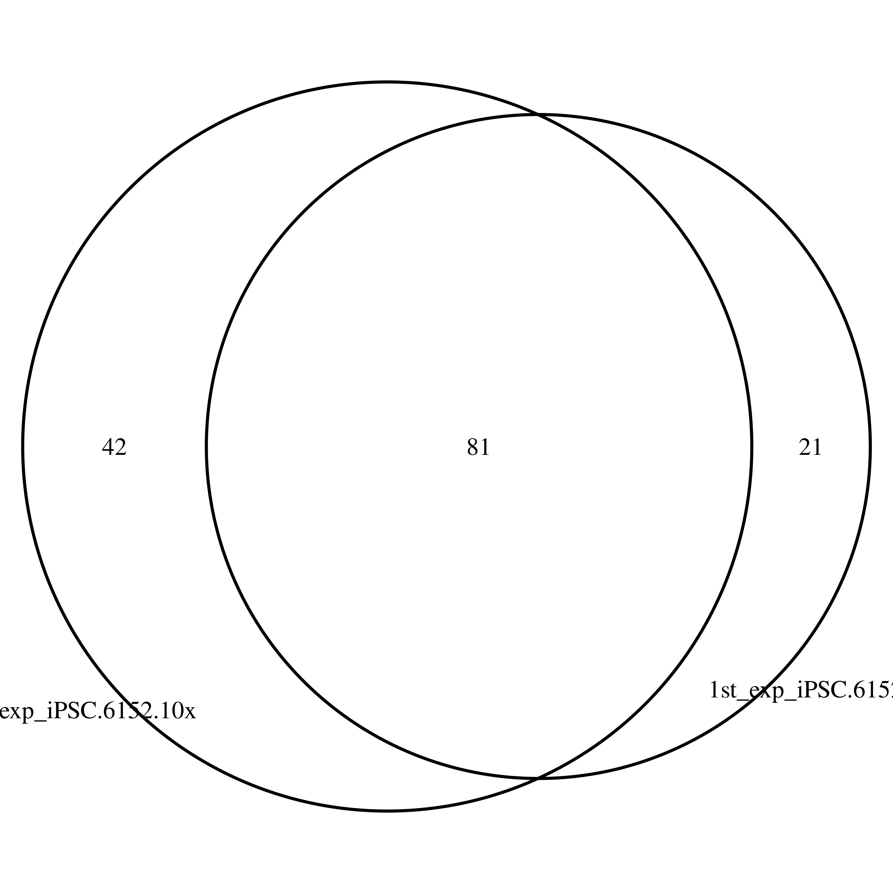
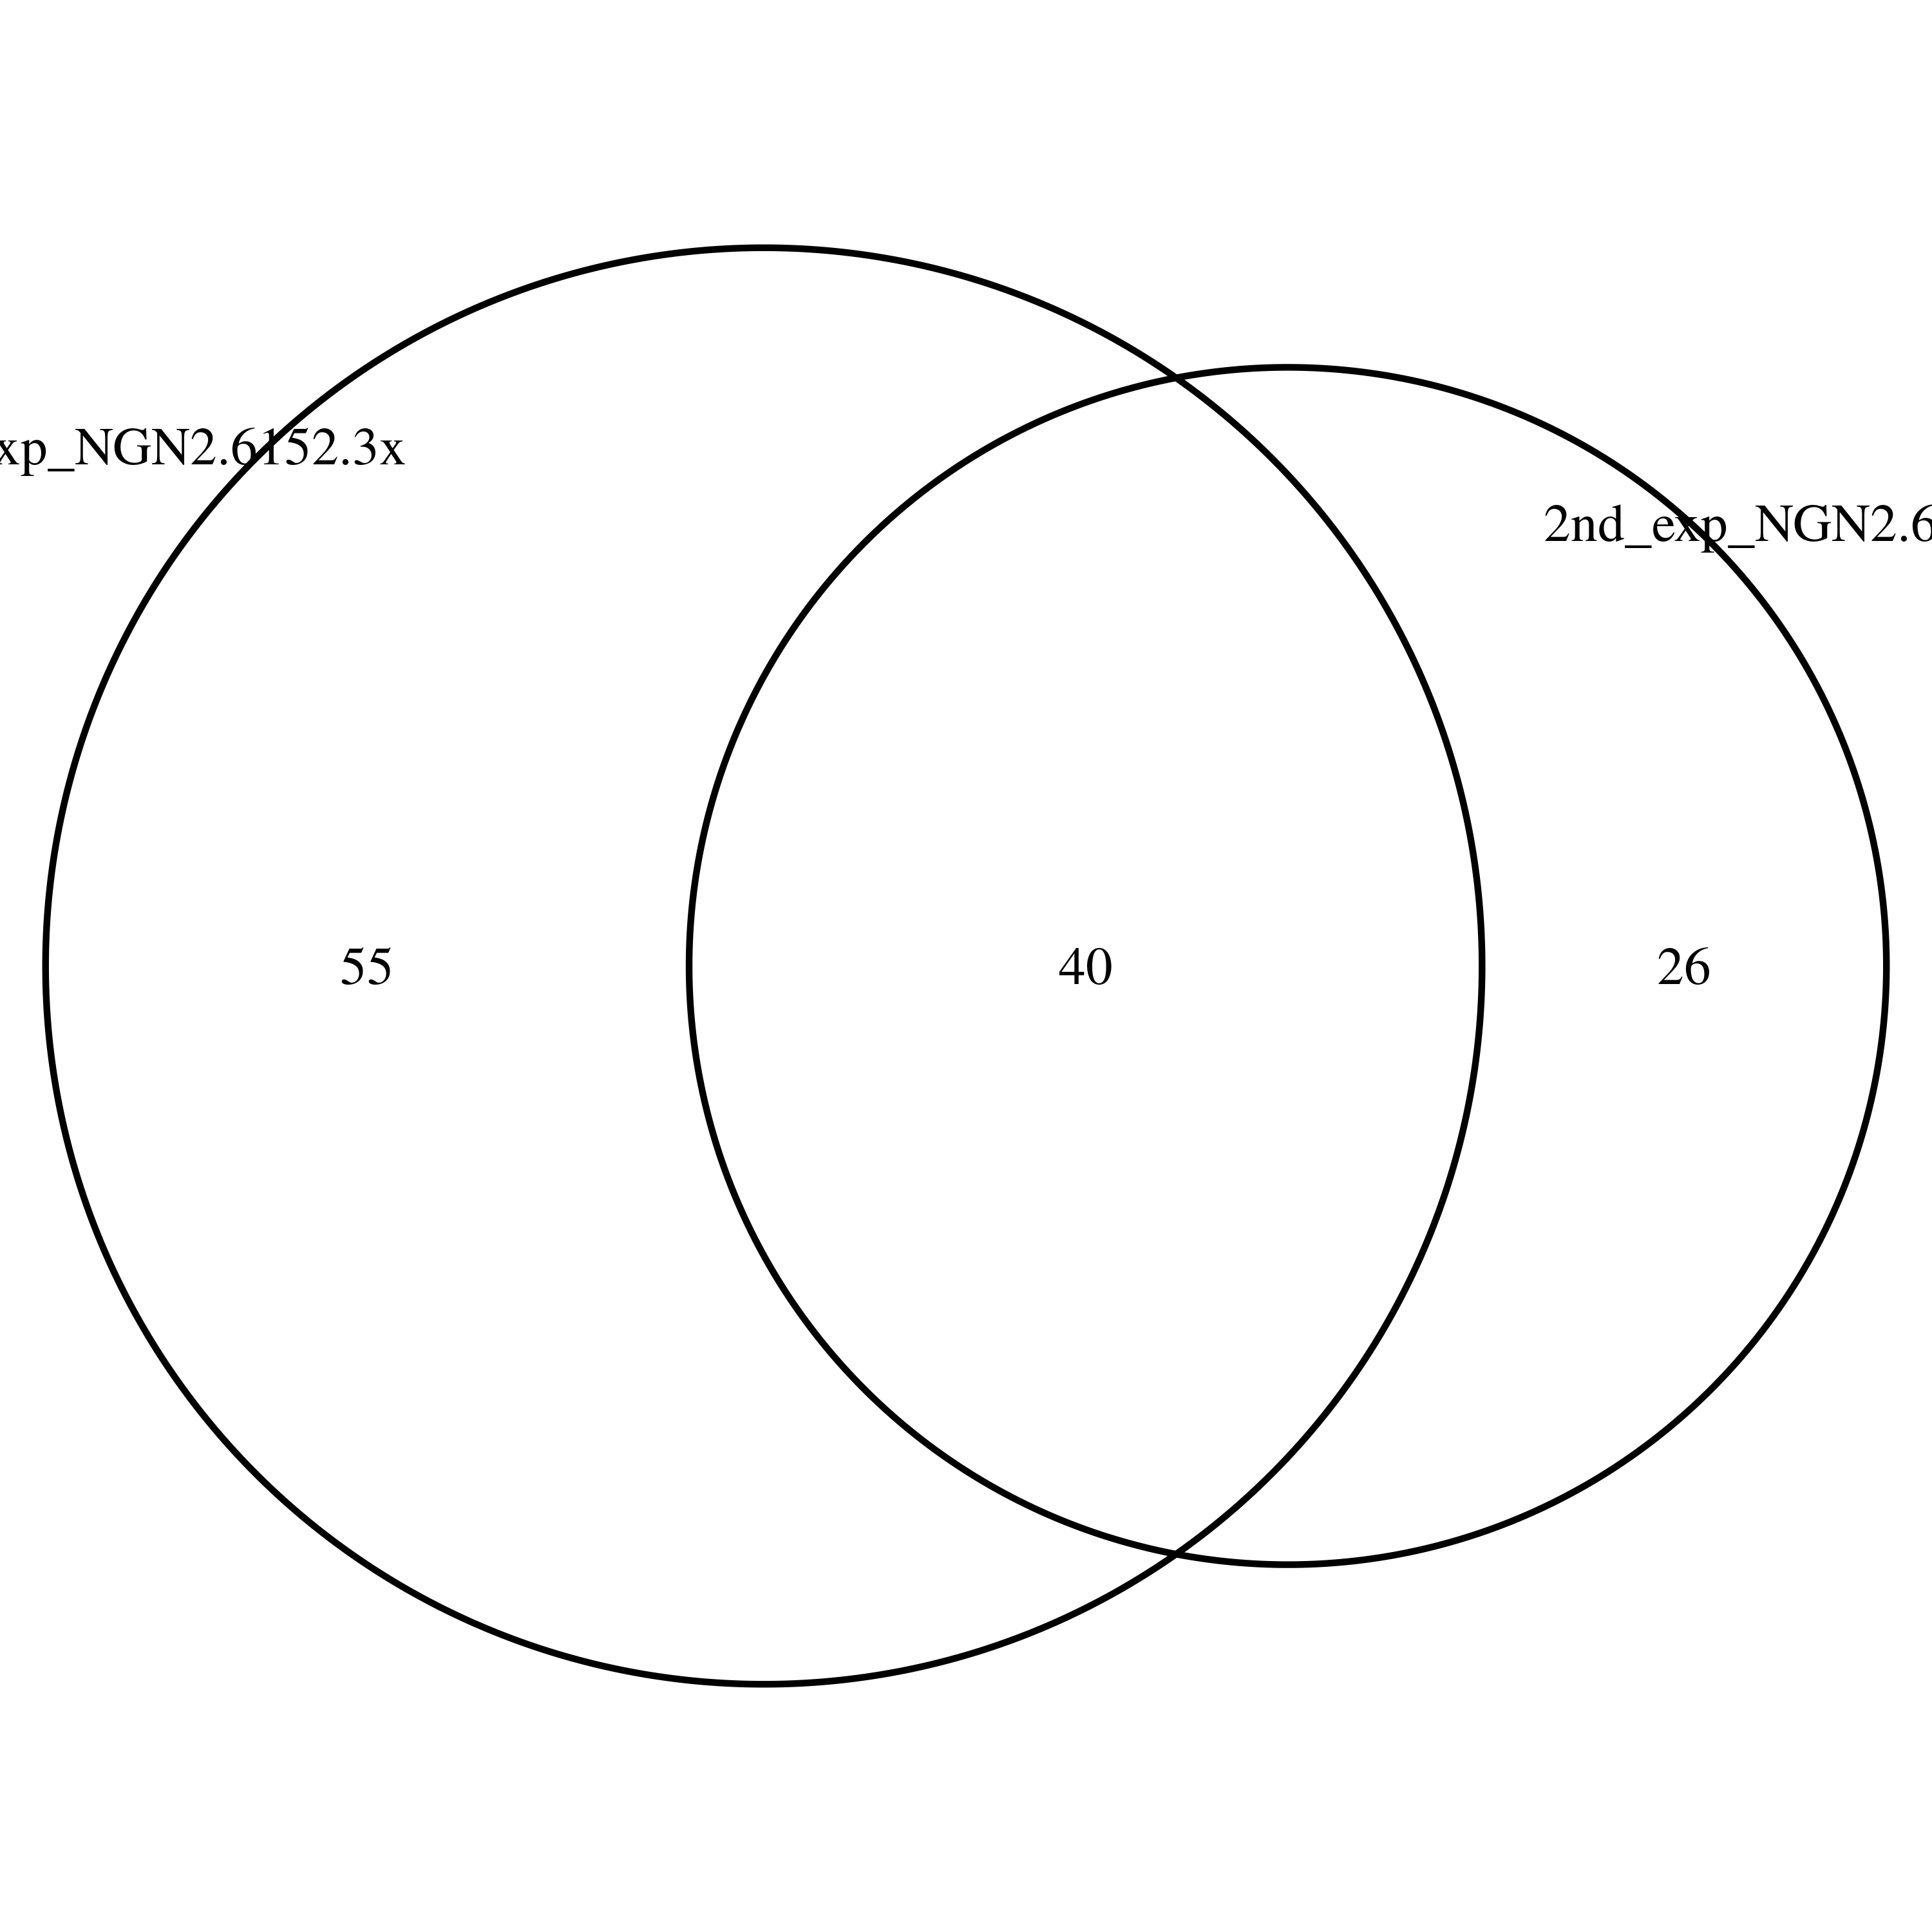
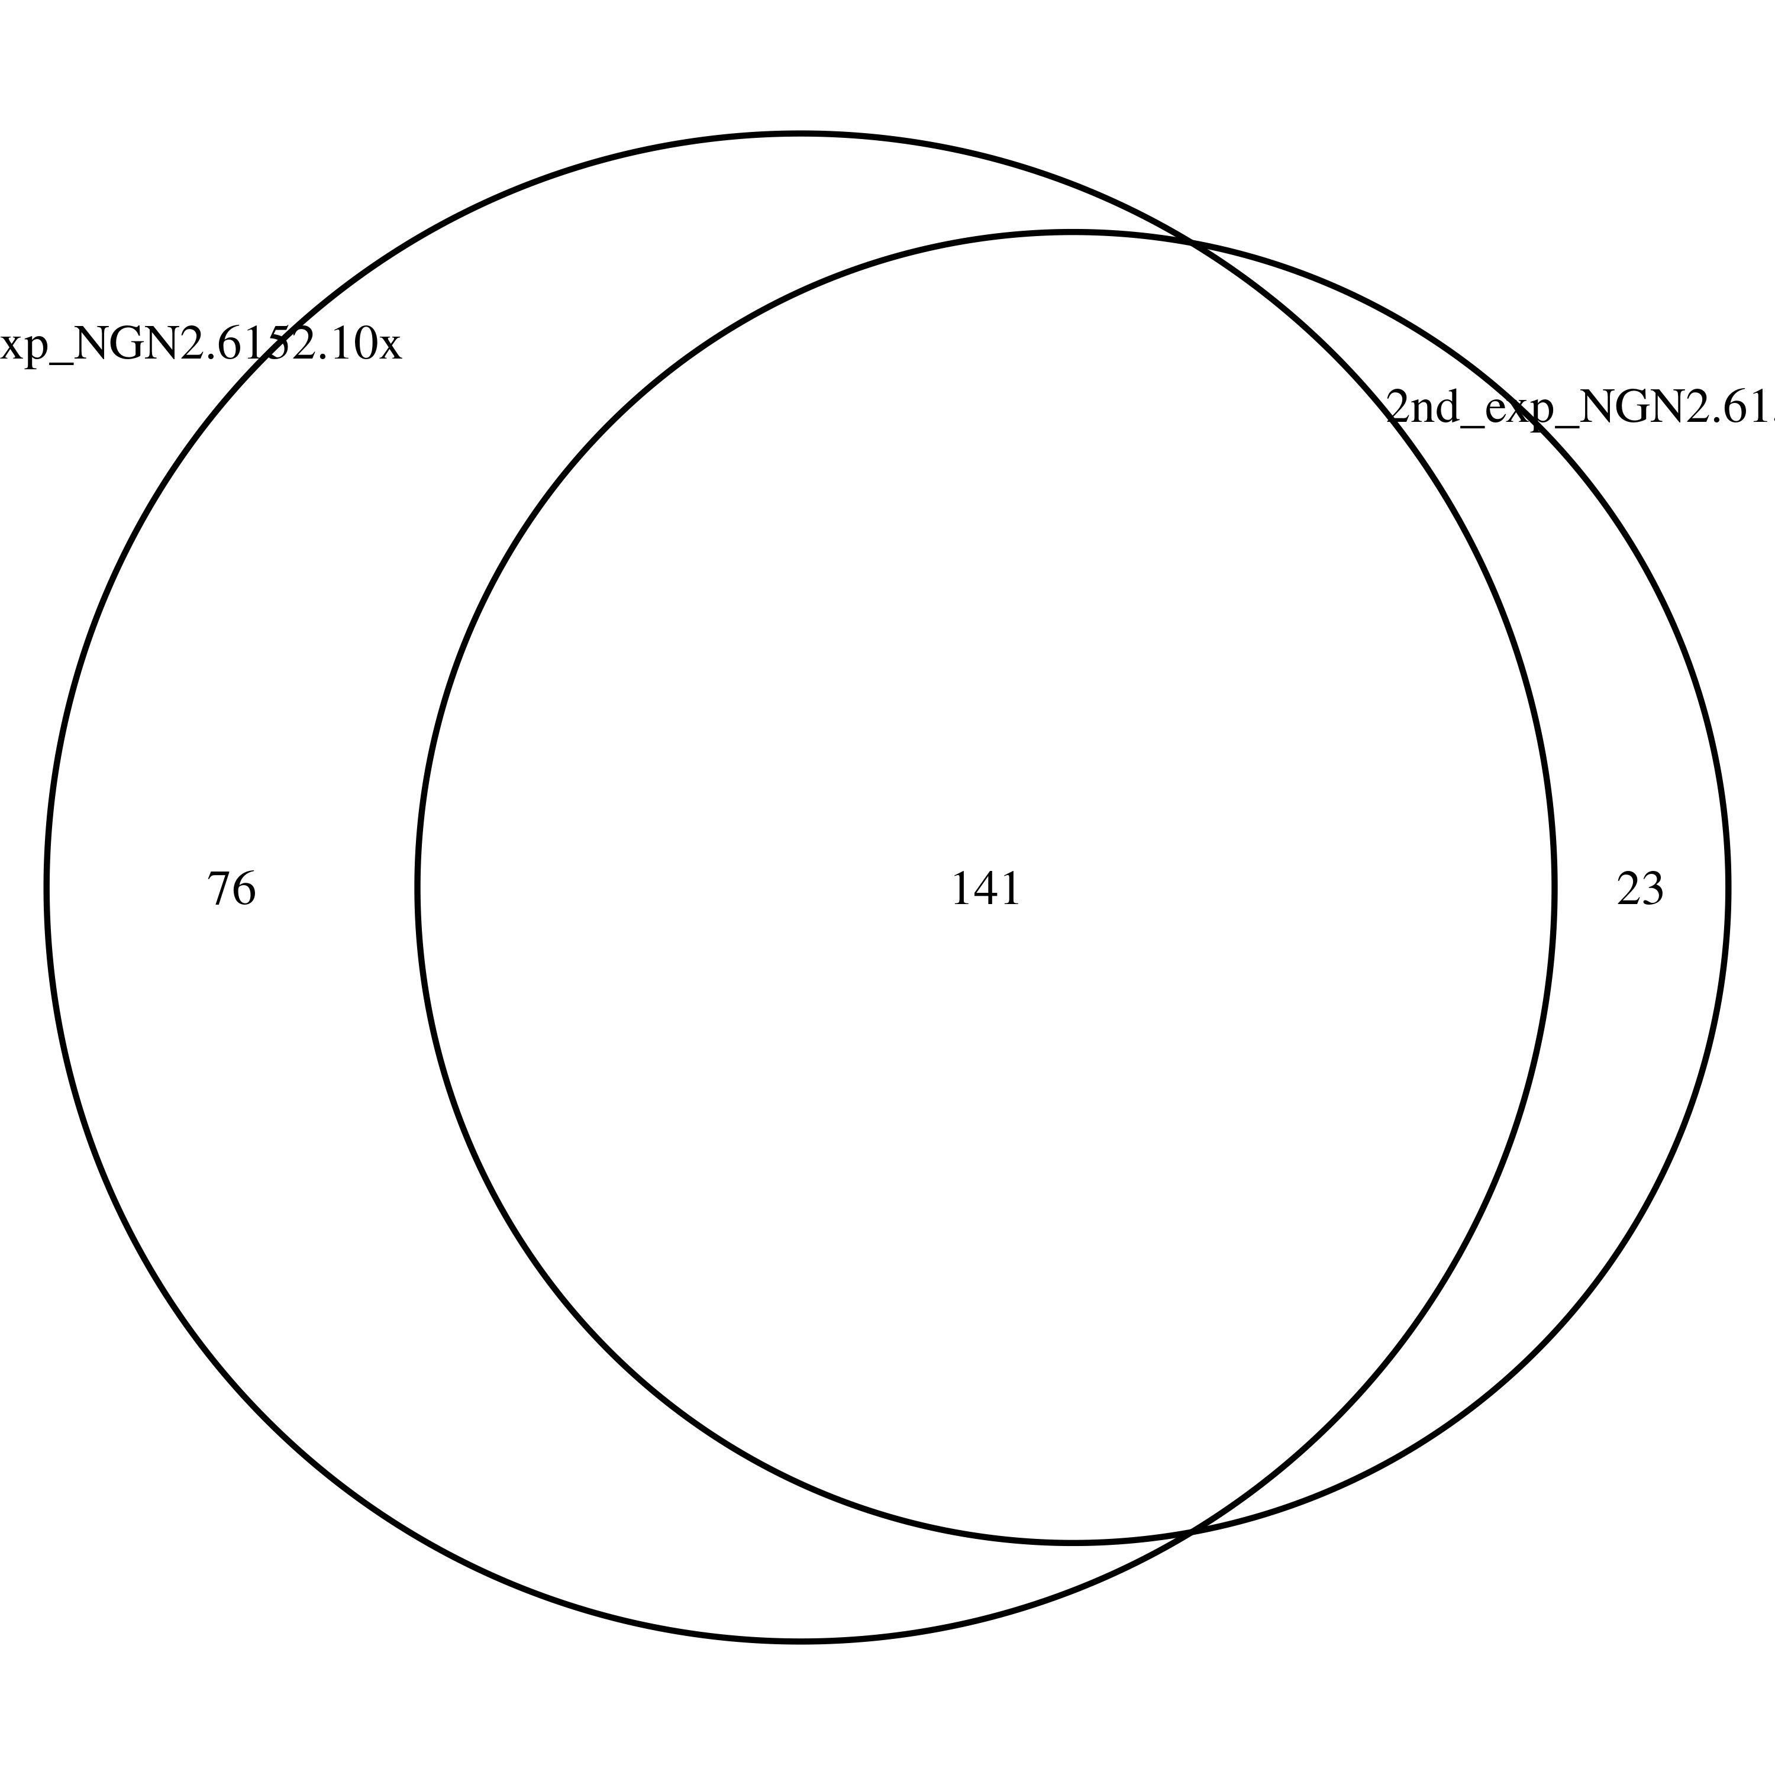
Overlapped DSG (1st and 2nd Exp.)
1st and 2nd exp. of 6152-3x in iPSC
1st and 2nd exp. of 6152-10x in iPSC
1st and 2nd exp. of 6152-3x in NGN2
1st and 2nd exp. of 6152-10x in NGN2

Slide 31
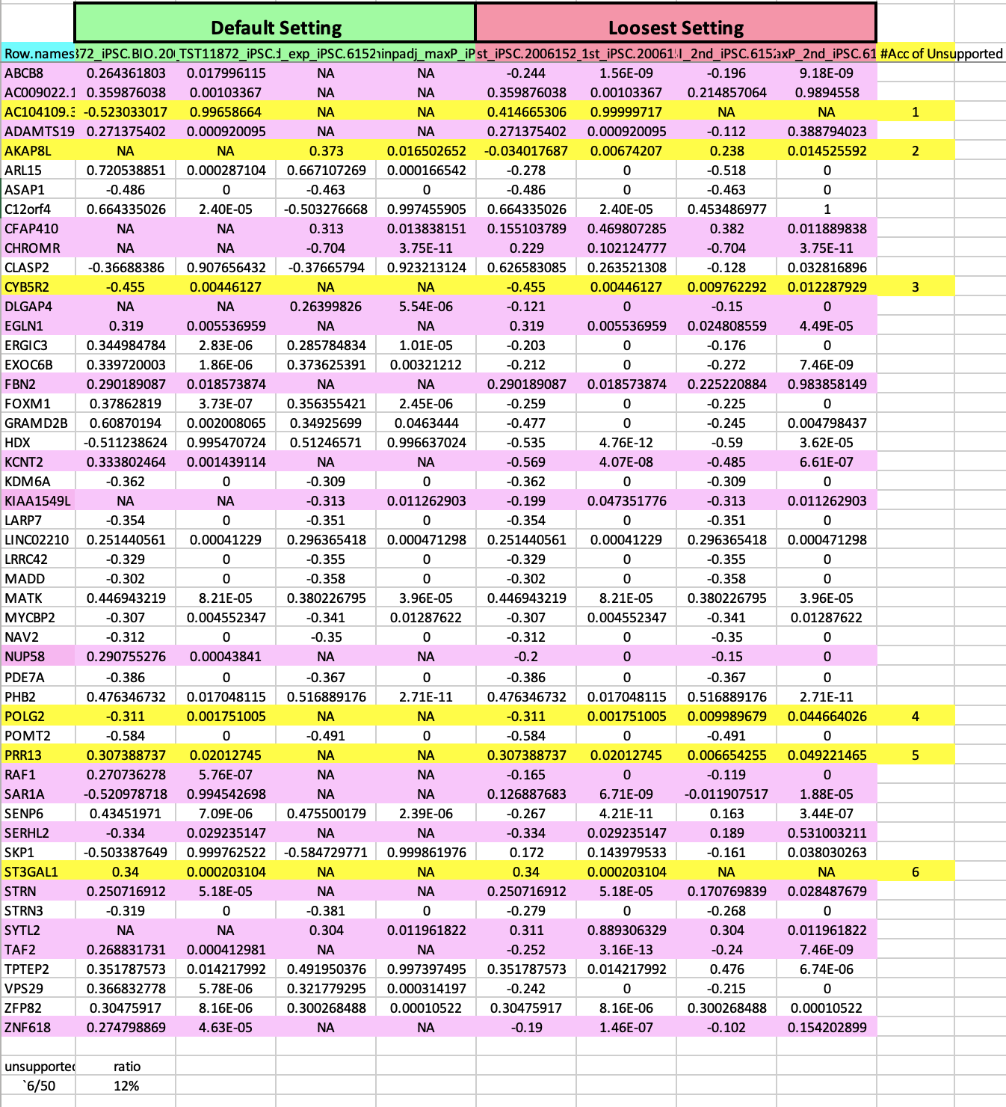
Overlapped DSG (1st and 2nd batch mutual support)
1st and 2nd batch of 6152-3x in iPSC

Slide 32
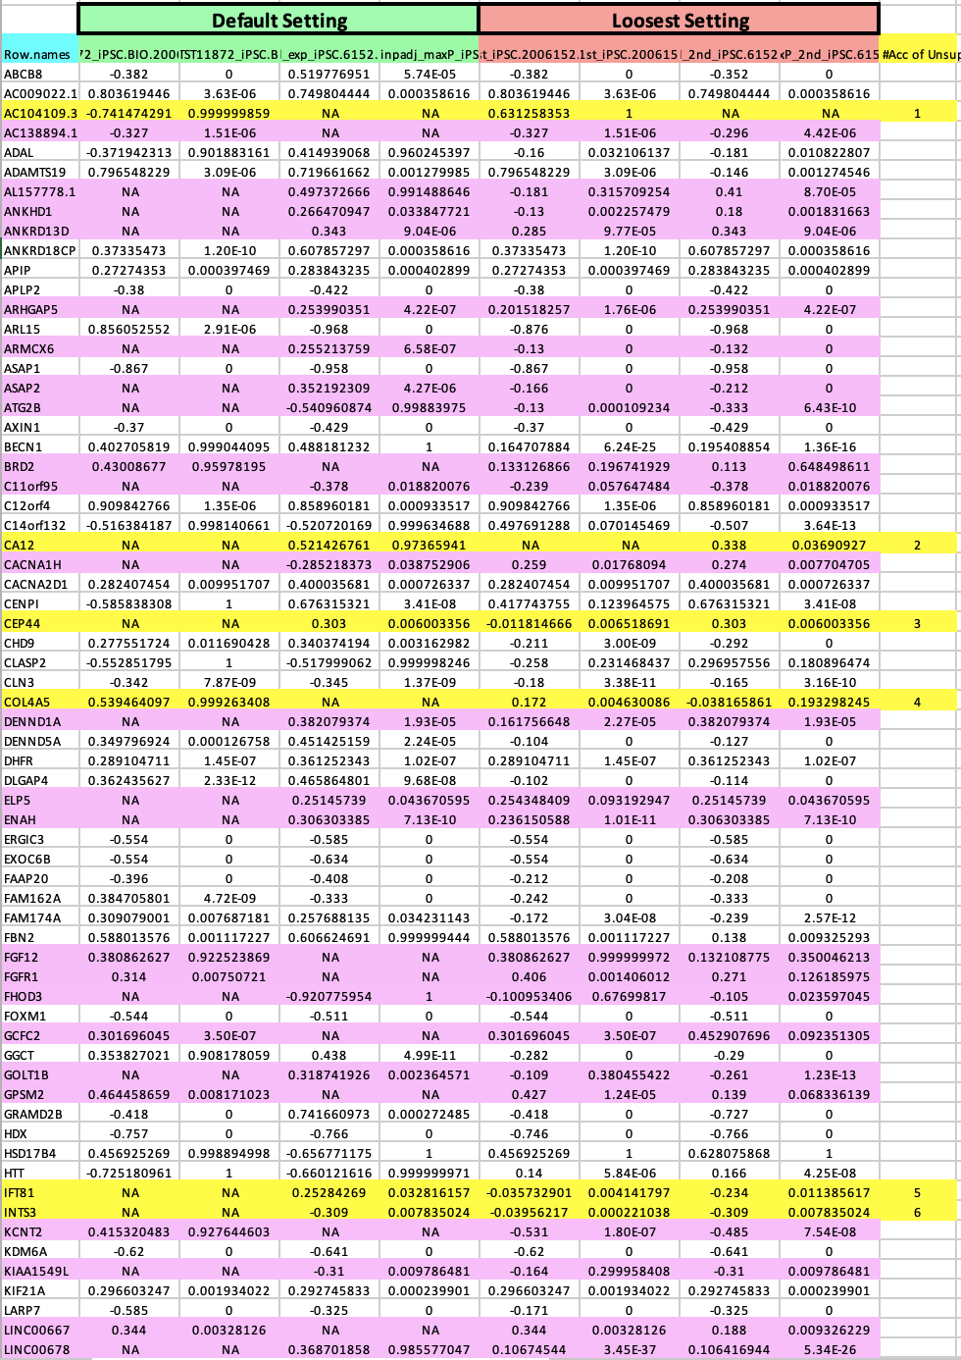
Overlapped DSG (1st and 2nd batch mutual support)
1st and 2nd batch of 6152-10x in iPSC

Slide 33
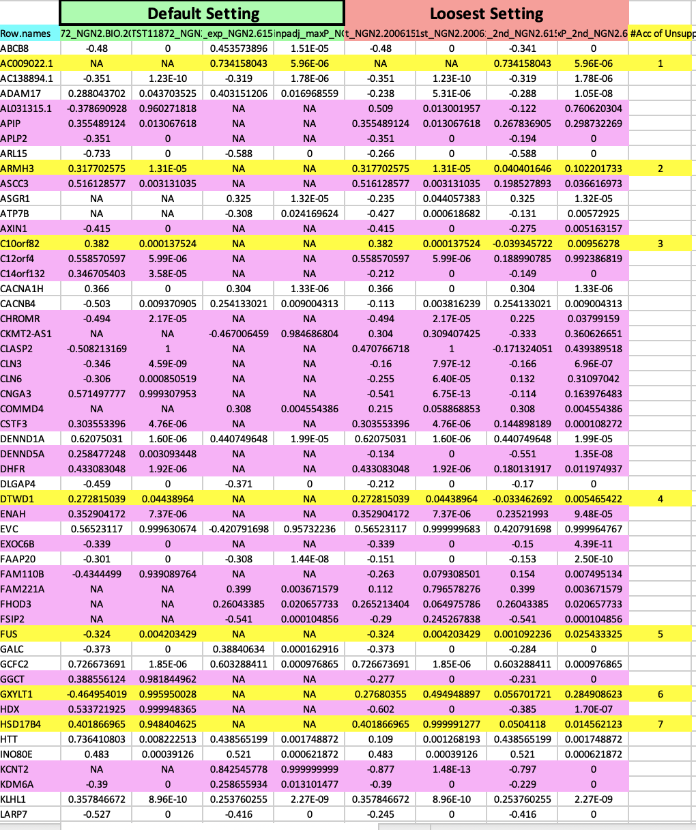
Overlapped DSG (1st and 2nd batch mutual support)
1st and 2nd batch of 6152-3x in NGN2

Slide 34
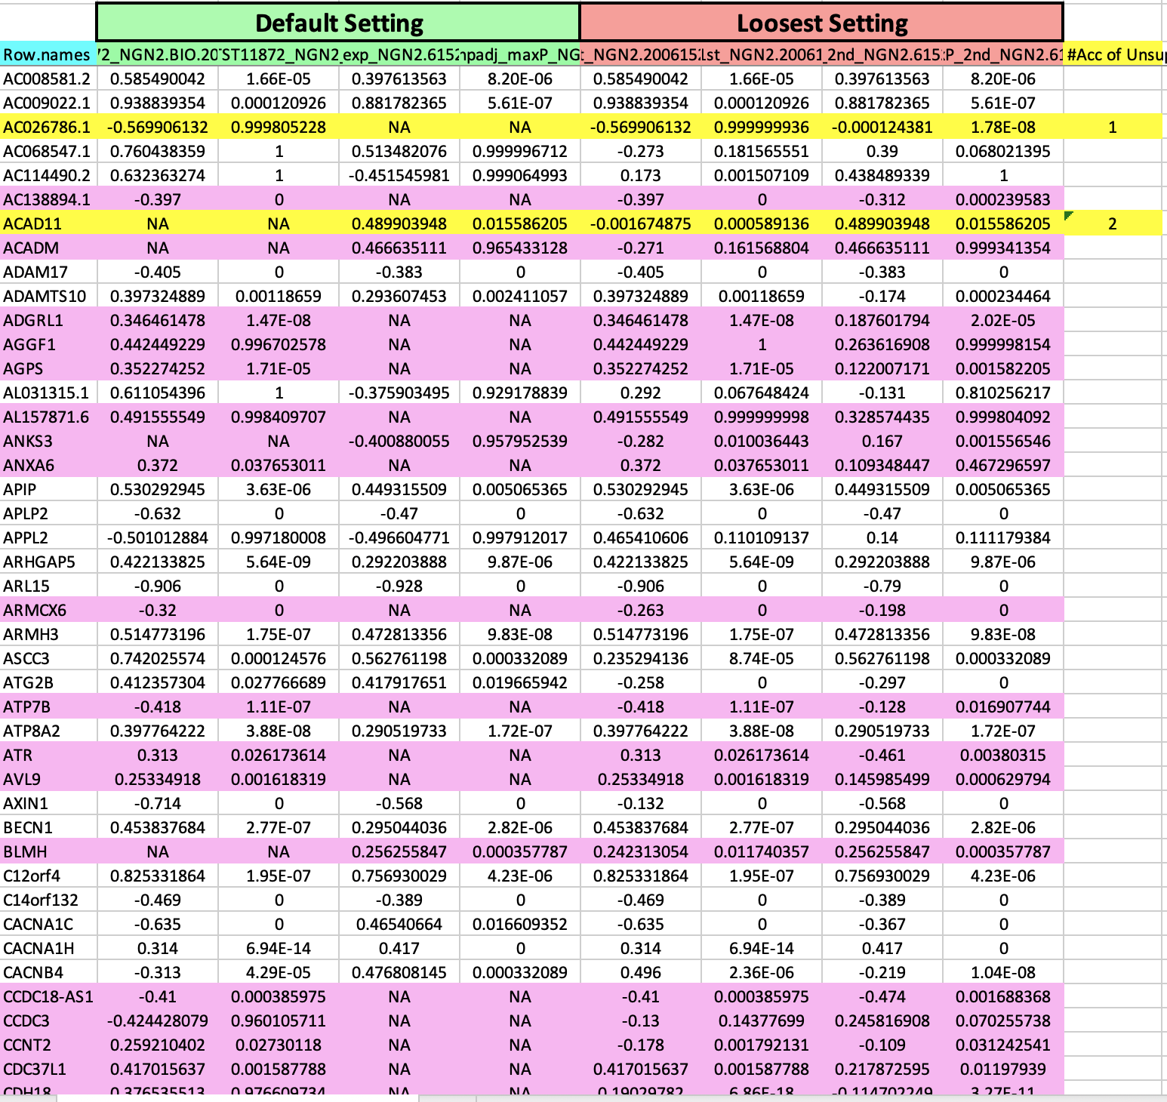
Overlapped DSG (1st and 2nd batch mutual support)
1st and 2nd batch of 6152-10x in NGN2

Slide 35
Conclusion and Next Steps
Ranked the compounds have fewer off-targets
Showed the common targets among the SM splicing enhancers
Explore potential novel splicing targets
Confirm the system difference between the different cell-systems (iPSC and NGN2)
Next steps
Preclinical Safety Assessment
RASLseq primer design for cost-efficient screen

Slide 36
Thank you everyone!

